Slide 1
PRESENTATION OF GRAPHIC AND UI/UX
PRESENTED BY , AARZOO VARAIYA
GUIDANCE BY : MANVI MEHTA

Slide 2
PRESENTATION OF PERSONAL INFORMATION
Hello , my name is Aarzoo Varaiya . I am Graphic and UI/UX designer . I have completed my graduation in computer engineering . I am pursuing certificate in graphic and UI/UX
design from tops technologies .
I am from Bhavnagar and currently living in Ahmadabad .Apart from that I like Traveling and watching movies .
That’s about me , Thank you .

Slide 3
WHAT IS GRAPHIC DESIGN ?
Graphic design is a visual communication an problem solving through the use of typography , photography and illustration .
It is used to make every day social media post , visiting card , Brand logo , Marketing campaigns , Advertising etc .

Slide 4
WHY CHOOSE IT FIELD ? AND WHY GRAPHICS AND UI/UX IN TREND ?
Initially I worked as a developer but later on I realized that it is not my cup of tea but I also realized that it is growing industry and still want to be a part of IT industry .
Apart from that Drawing has always been my strength so thought of utilizing that strength in this field . So keep on and that's why I am here .

Slide 5
WHY GRAPHIC AND UI/UX IN TREND ?
Graphic design and UI/UX design are popular right now because everything is moving online. Businesses want their websites and apps to look great and be easy to use so they can attract more customers. Designers have better tools now to create cool graphics and interfaces that work well on phones, tablets, and computers. Good design also helps companies build a strong identity and communicate their message .

Slide 6
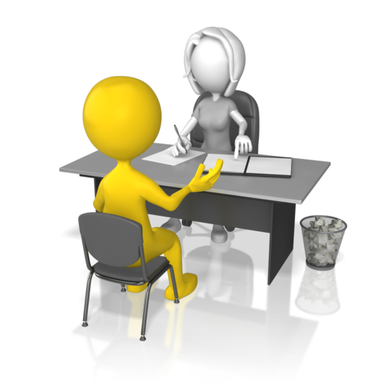
HR QUESTIONS
Short term goal
Long term goal
Strength
Weakness
Technical skills
Hobbies

Slide 7
SHORT TERM GOAL
To complete a course or workshop on UX/UI fundamentals within the next three months, enhancing my skills in wire framing, prototyping, and user research. Also want to make strong portfolio .

Slide 8
LONG TERM GOAL
In next five years my goal is to be experienced UI/UX designer . I also want to achive mileston through my work .also want to cultivating a strong network of clients and collaborators to help and inspire people.

Slide 9
MY STRENGTH
Self motivated
Teamwork
Punctual
Healthy lifestyle
Attention to detail
MY WEEKNESS
Passive
Emotional
Self critical

Slide 10
TECHNICAL SKILLS
Adobe illustrator
Adobe Photoshop
Adobe xd
Corel draw
Figma
HOBBIES
Drawing
Teamwork
Listen to music

Slide 11
THANK YOU

